Slide 1
Introduction to Microservices
Name:Puja Pandey
Emp Id:784462

Slide 2
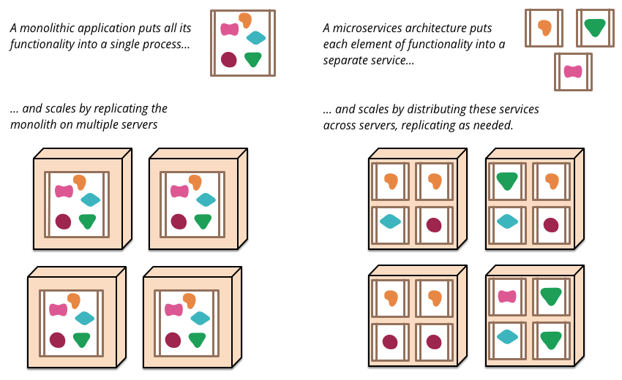
Monolithic Vs Microservices

Slide 3
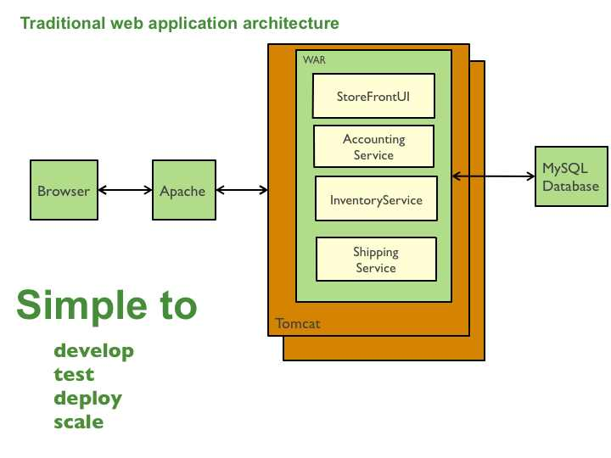
Monolithic Architecture

Slide 4
Monolithic Challenges
Slower IDE
Slower Web Container
Continuous Deployment is difficult
Scaling of application is cubersome
Reliability
Barrier of adopting new technologies
Must be written in a single language

Slide 5
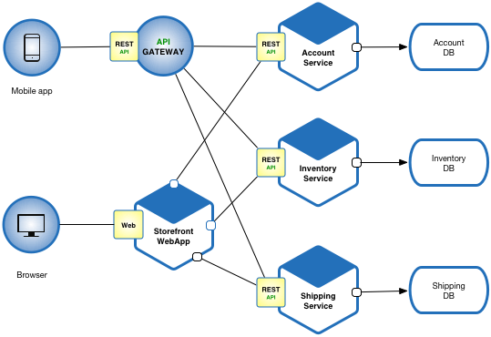
Microservices Architecture

Slide 6
Advantages of Microservice
New technology and process Adoption
Dynamic Scaling
Faster release cycle
Enables the continuous delivery and deployment of large, complex applications
Easier to understand for new developer
Improved fault isolation
Eliminates any long term commitment to a technology stack

Slide 7
How do you break a monolith to microservices
Primary consideration:business functionality
Noun based(catalog,cart,customer)
Verb based(search,checkout,shipping)
Single responsibility principle
Bounded Context

Slide 8
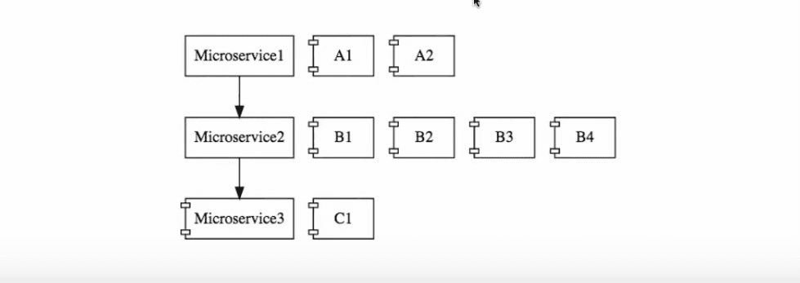
Challenges with Microservices
1. Configuration management
Dyanmic Scale up and Scale Down
Visibility
Pack of Cards

Slide 9
Introduction to Spring Cloud
Spring Cloud provides tools for developers to quickly build some of the common patterns in distributed systems .
Latest release version is Hoxton SR5
<dependency>
<groupId>org.springframework.cloud</groupId>
<artifactId>spring-cloud-dependencies</artifactId>
<version>Hoxton.SR5</version>
<type>pom</type>
<scope>runtime</scope>
</dependency>

Slide 10
Features of Spring cloud
Distributed/versioned configuration
Service registration and discovery
Routing
Service-to-service calls
Load balancing
Circuit Breakers
Distributed messaging

Slide 11
Spring cloud config server
Microservice1
Microservice2
Microservice3
Spring Cloud Config Server
Used to expose all the configuration from git to microservices
Git

Slide 12
Dynamic Scale up and Scale Down
Ribbon load balancing-Client side load balancing
Service Discovery-Naming Server(Eureka naming server)
Feign-Easier Rest Client

Slide 13
Ribbon load Balancing and Eureka Server
MS1
Naming server
Ribbon
MS2 Instance A
MS2 Instance B
MS2 Instance C

Slide 14
Rest Client -Feign

Slide 15
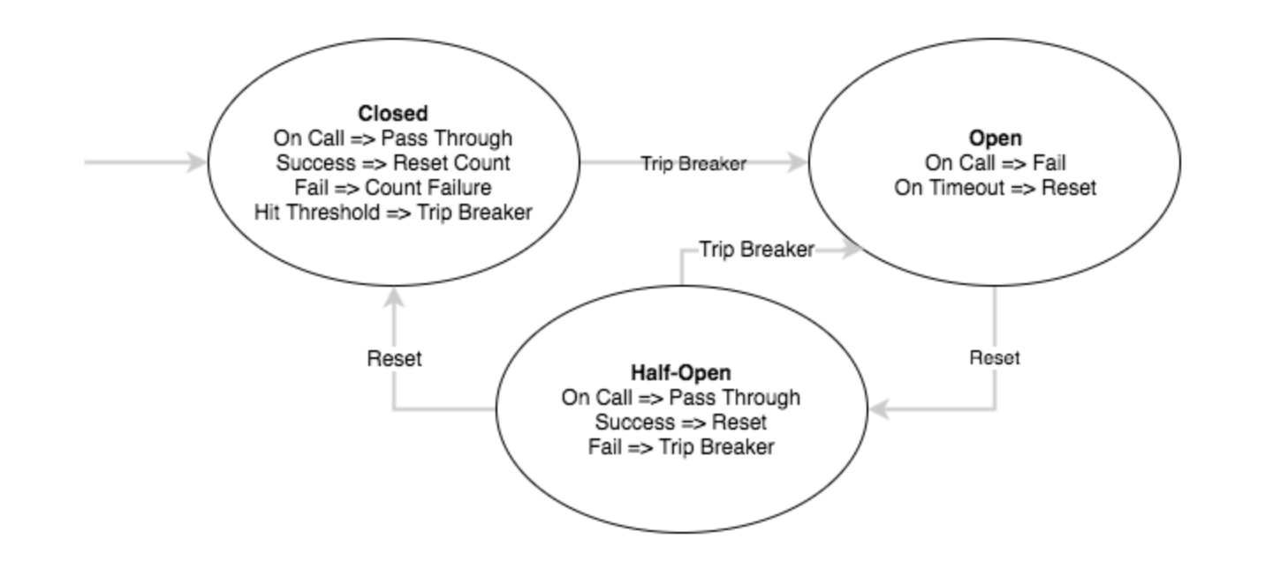
Circuit Breaker Pattern
Help us to build fault tolerant and resilient system
Circuit breaker has 3 distinct states:

Slide 16
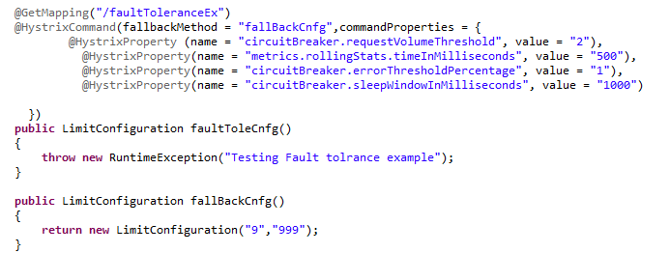
Contd:
Example:

Slide 17
Api GateWay
Layered Architecture(Typical JEE Structure)
Web
Spring MVC,Angular,
Servlet,JSP
Business
Spring Framework
Data
Hibernate,Ibatis,Spring Data JPA

Slide 18
Contd:
Specific Common Part is layered Architecture
Logging
Security
Performance
Auditing
Solution: Aspect Oriented Programming

Slide 19
Need of Api Gateway
Features common across microservices
authentication
logging
auditing
rate limiting
Solution :Api Gateway(Netflix Zuul)
MS1
MS2
MS3
MS4
MS5

Slide 20
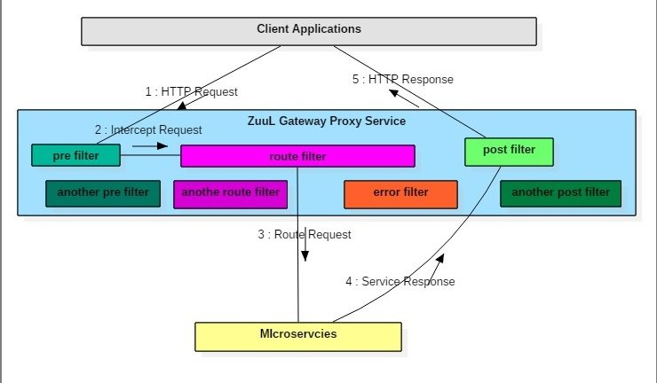
Zuul Components
,
Pre Filter
Post filter
Error filter
Route filter

Slide 21
References
https://articles.microservices.com/monolithic-vs-microservices-architecture-5c4848858f59
https://microservices.io/patterns/monolithic.html
https://dzone.com/articles/implementing-a-bounded-context
https://www.springboottutorial.com/introduction-to-api-gateways-with-microservices
https://howtodoinjava.com/spring-cloud/spring-cloud-api-gateway-zuul/

Slide 22
Thank You

Slide 23
Thank you

